Slide 1
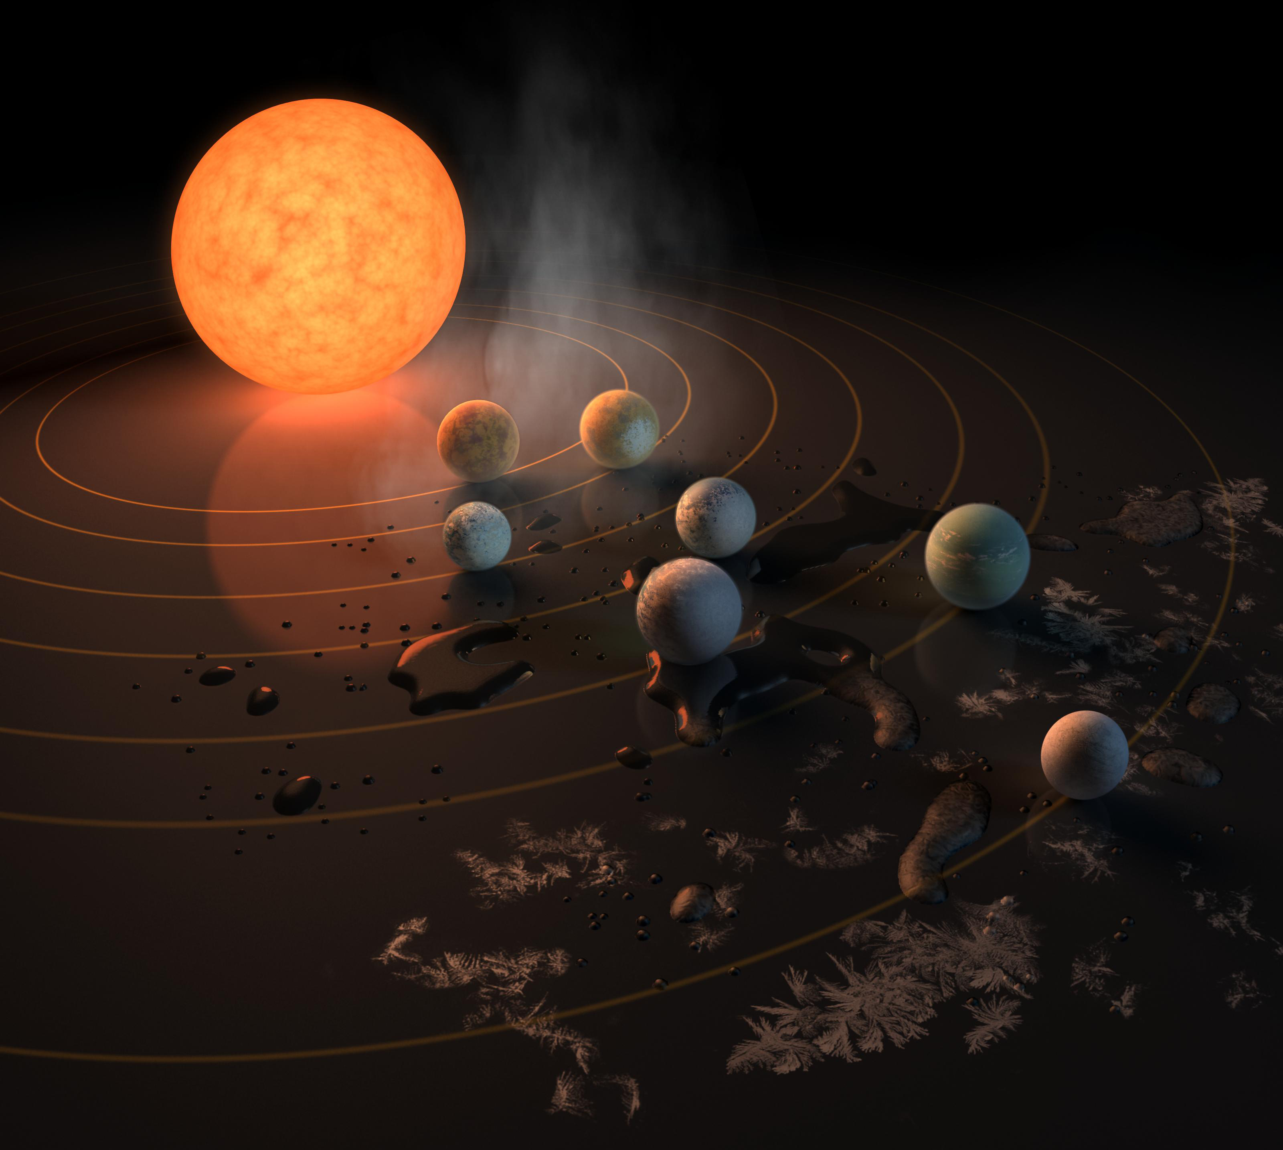
Exoplanets

Slide 2
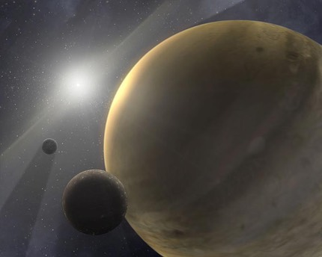
How recently did astronomers begin to discover planets outside our solar system?
Within the last 30 years
The mid 1900s
The mid 1800s
The mid 1700s

Slide 3
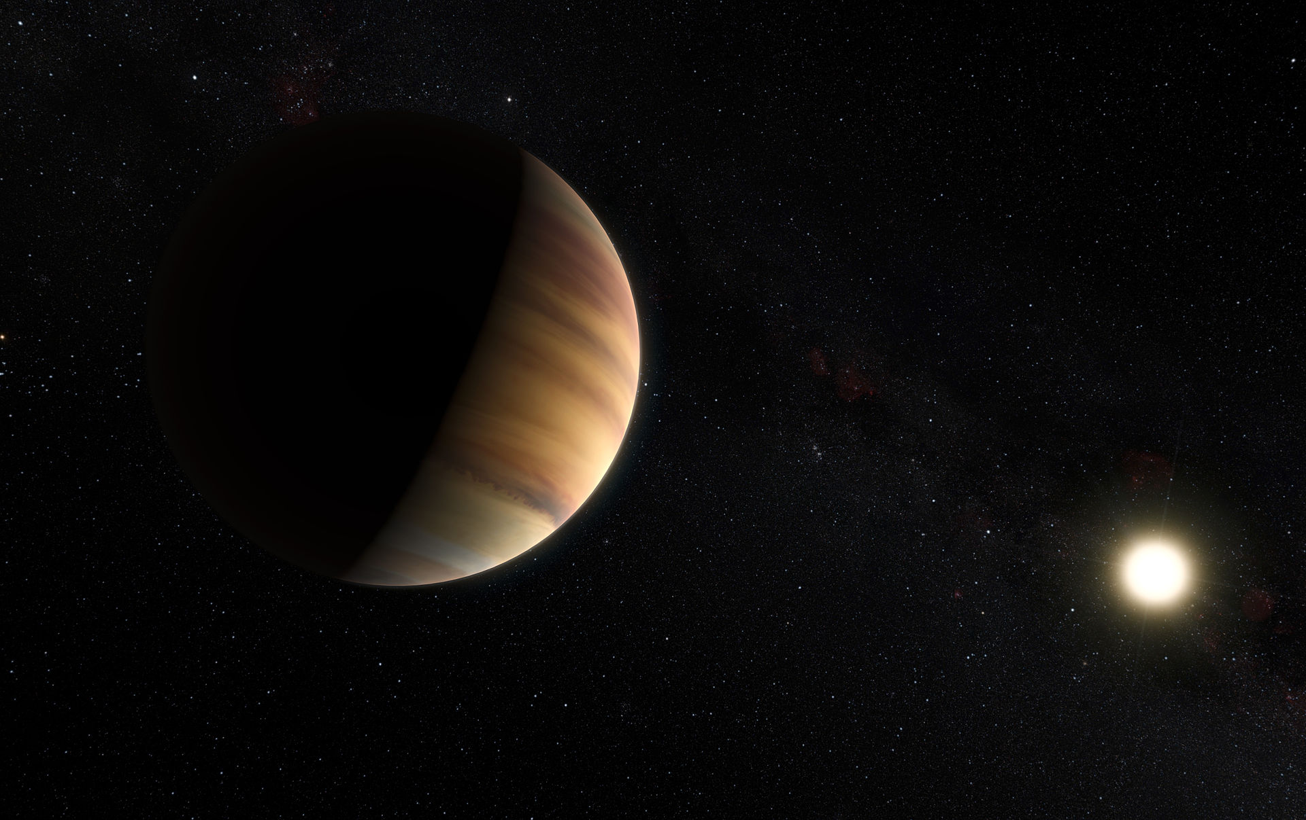
How recently did astronomers begin to discover planets outside our solar system?
Within the last 30 years

Slide 4
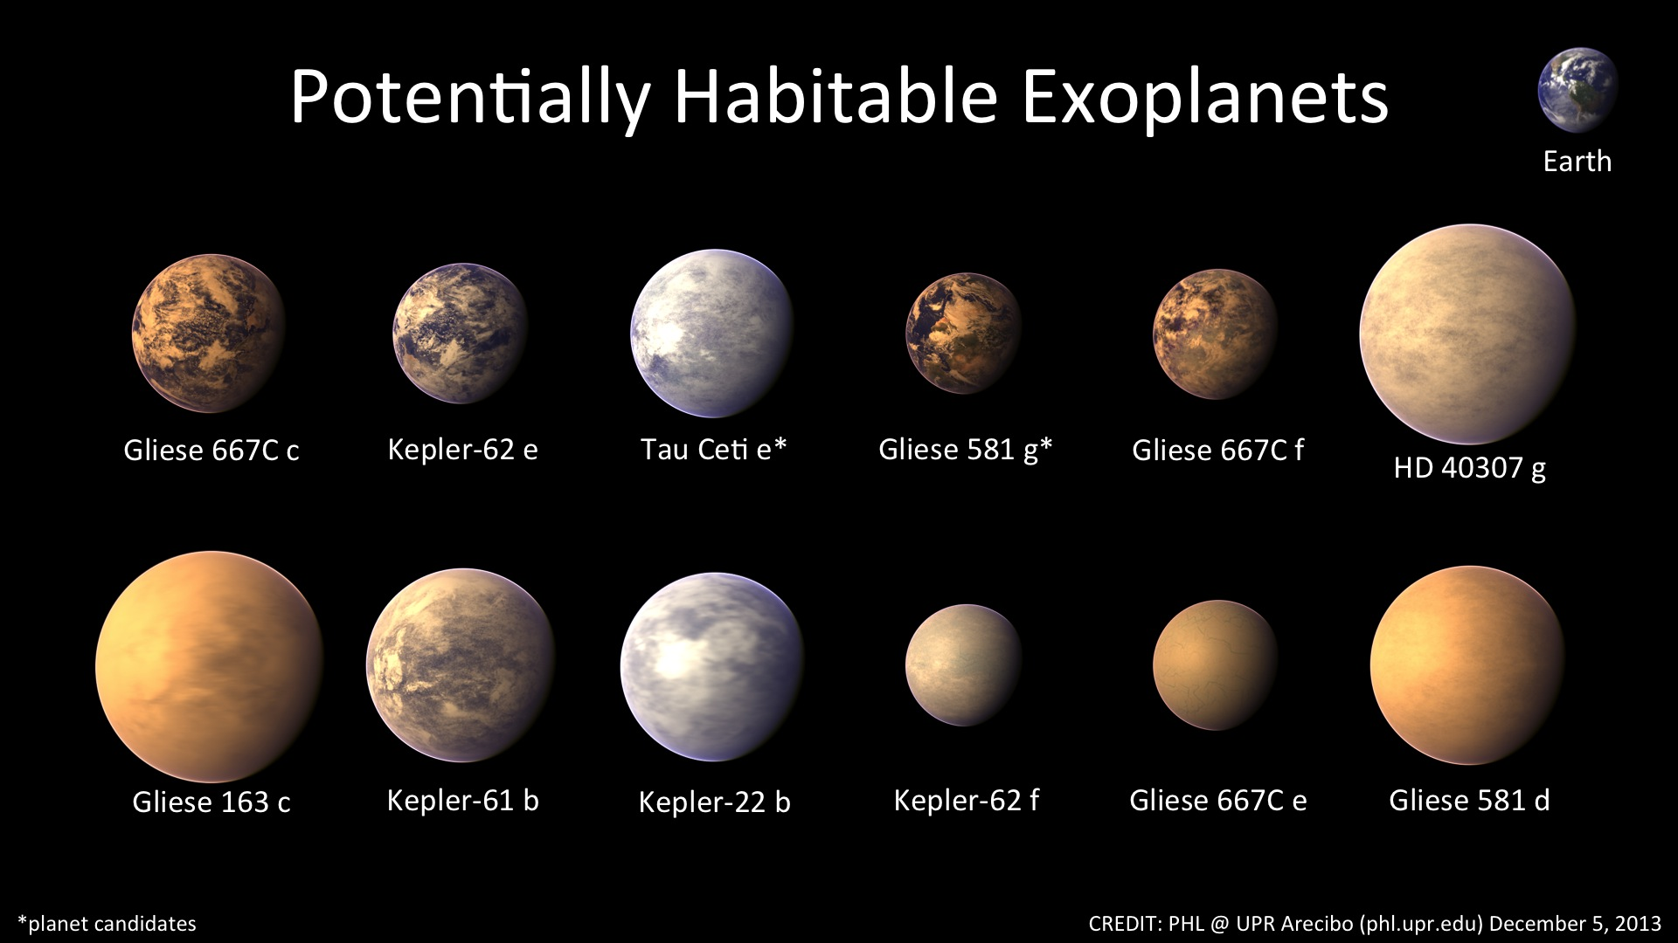
Which of the following is not a method used by astronomers to find exoplanets?
Directly imaging the planets using telescopes
Measuring the Doppler shift of the star to detect small 'wobbles' caused by orbiting planets
Measuring changes in the intensity of the star caused by transiting planets
Using radio waves to 'ping' extra-solar planets like a ship's sonar

Slide 5
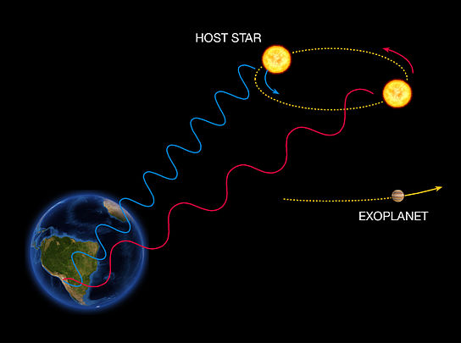
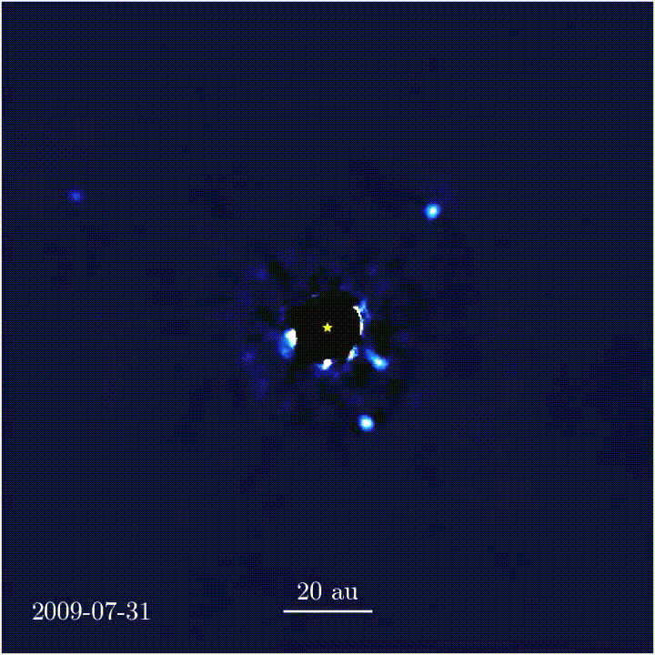
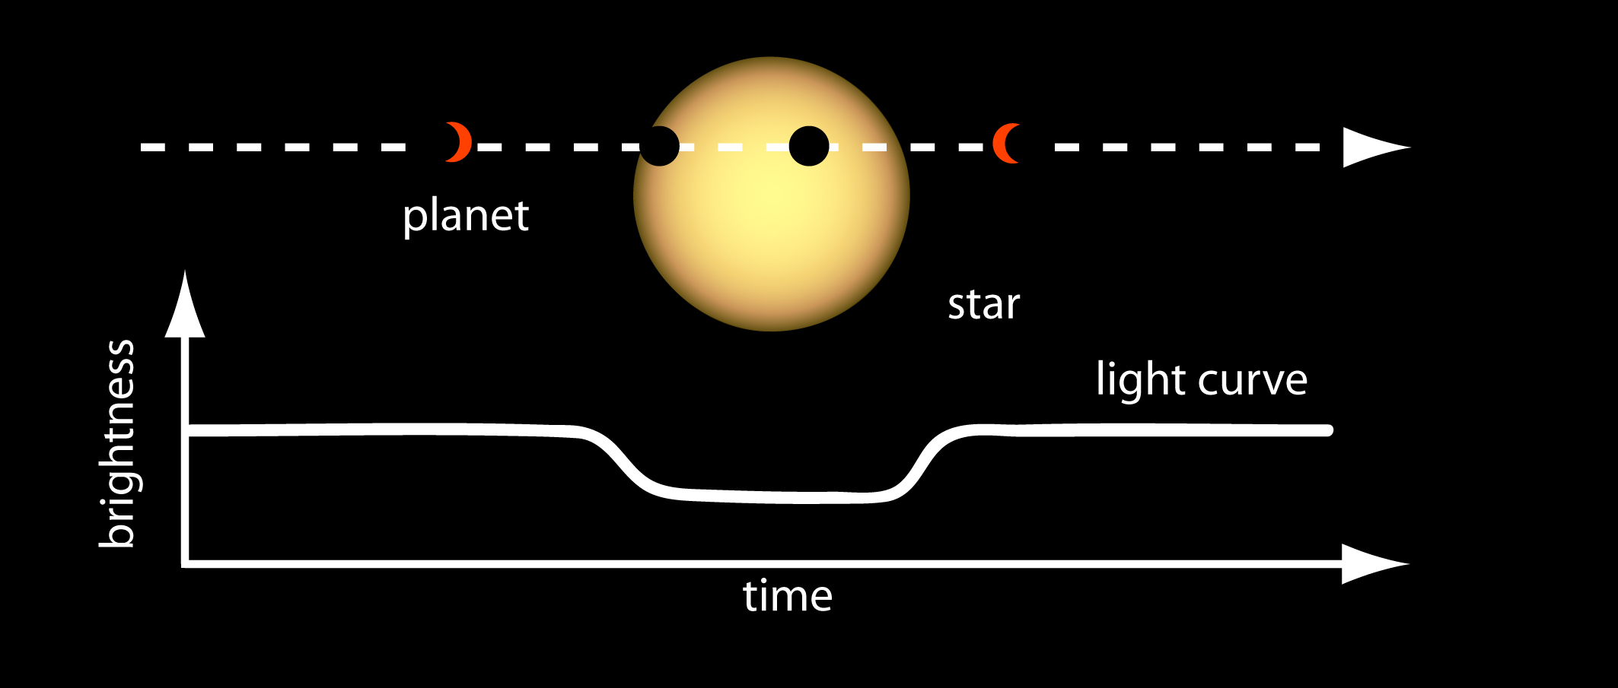
Which of the following is not a method used by astronomers to find exoplanets?
Directly imaging the planets using telescopes
Measuring the Doppler shift of the star to detect small 'wobbles' caused by orbiting planets
Measuring changes in the intensity of the star caused by transiting planets
Using radio waves to 'ping' extra-solar planets like a ship's sonar

Slide 6
Roughly how many exoplanets have astronomers discovered thus far?
50
500
5,000
50,000

Slide 7
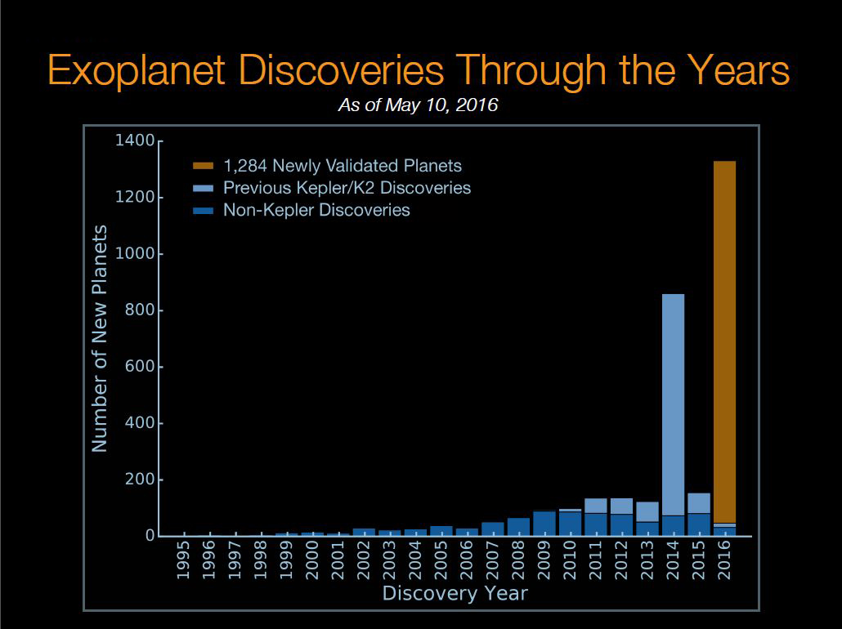
Roughly how many exoplanets have astronomers discovered thus far?
5,000

Slide 8
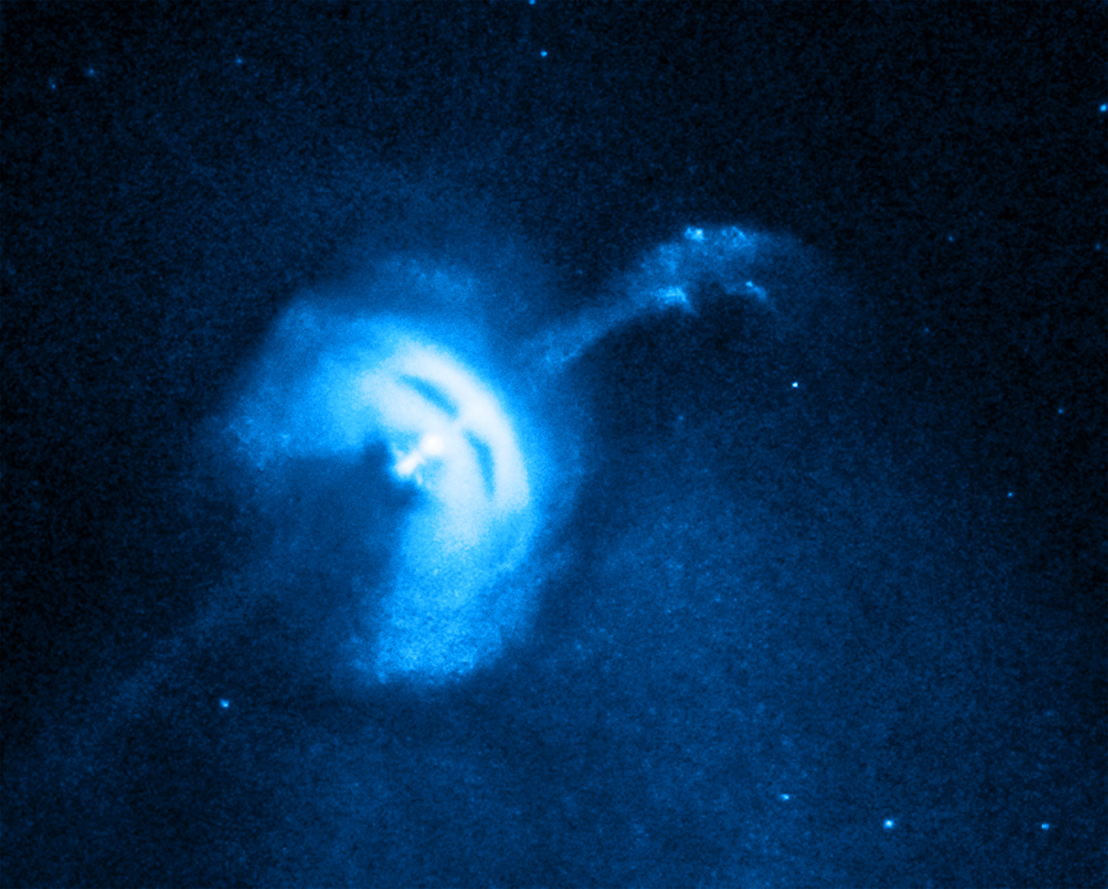
Which of these strange types of objects have astronomers discovered outside of our solar system?
Large gas giants with very small orbits called 'Hot Jupiters'
Planets in orbit around stellar remnants like neutron stars and pulsars
Massive terrestrial planets called 'Super Earths'
Free-floating planets that drift through interstellar space
Vela Pulsar, in X-ray

Slide 9
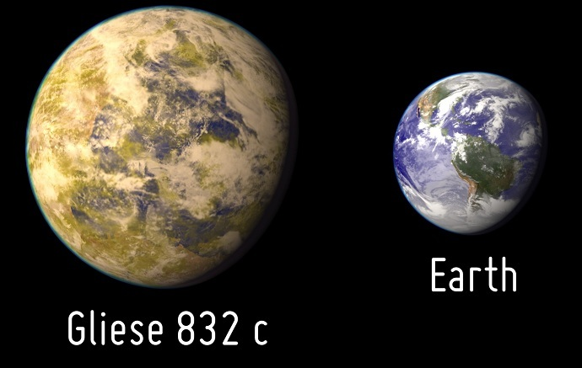
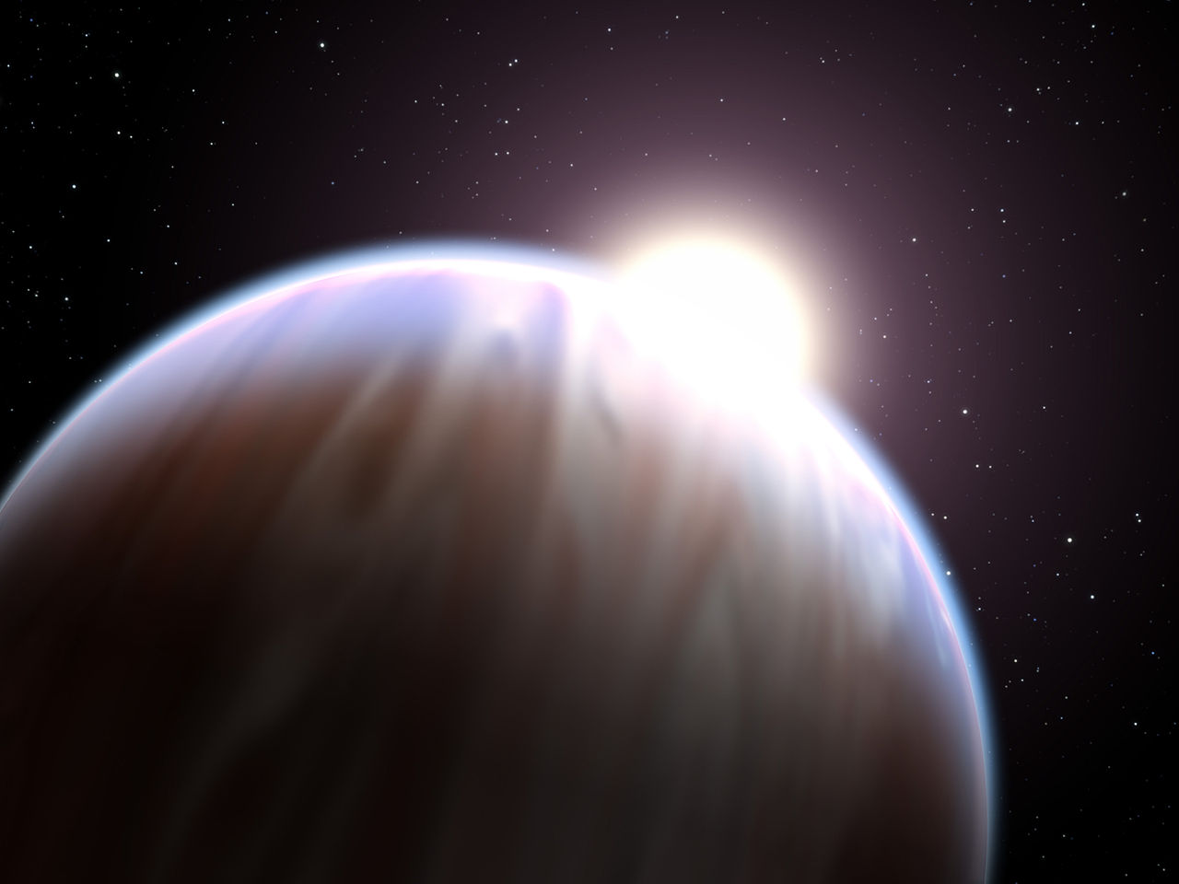
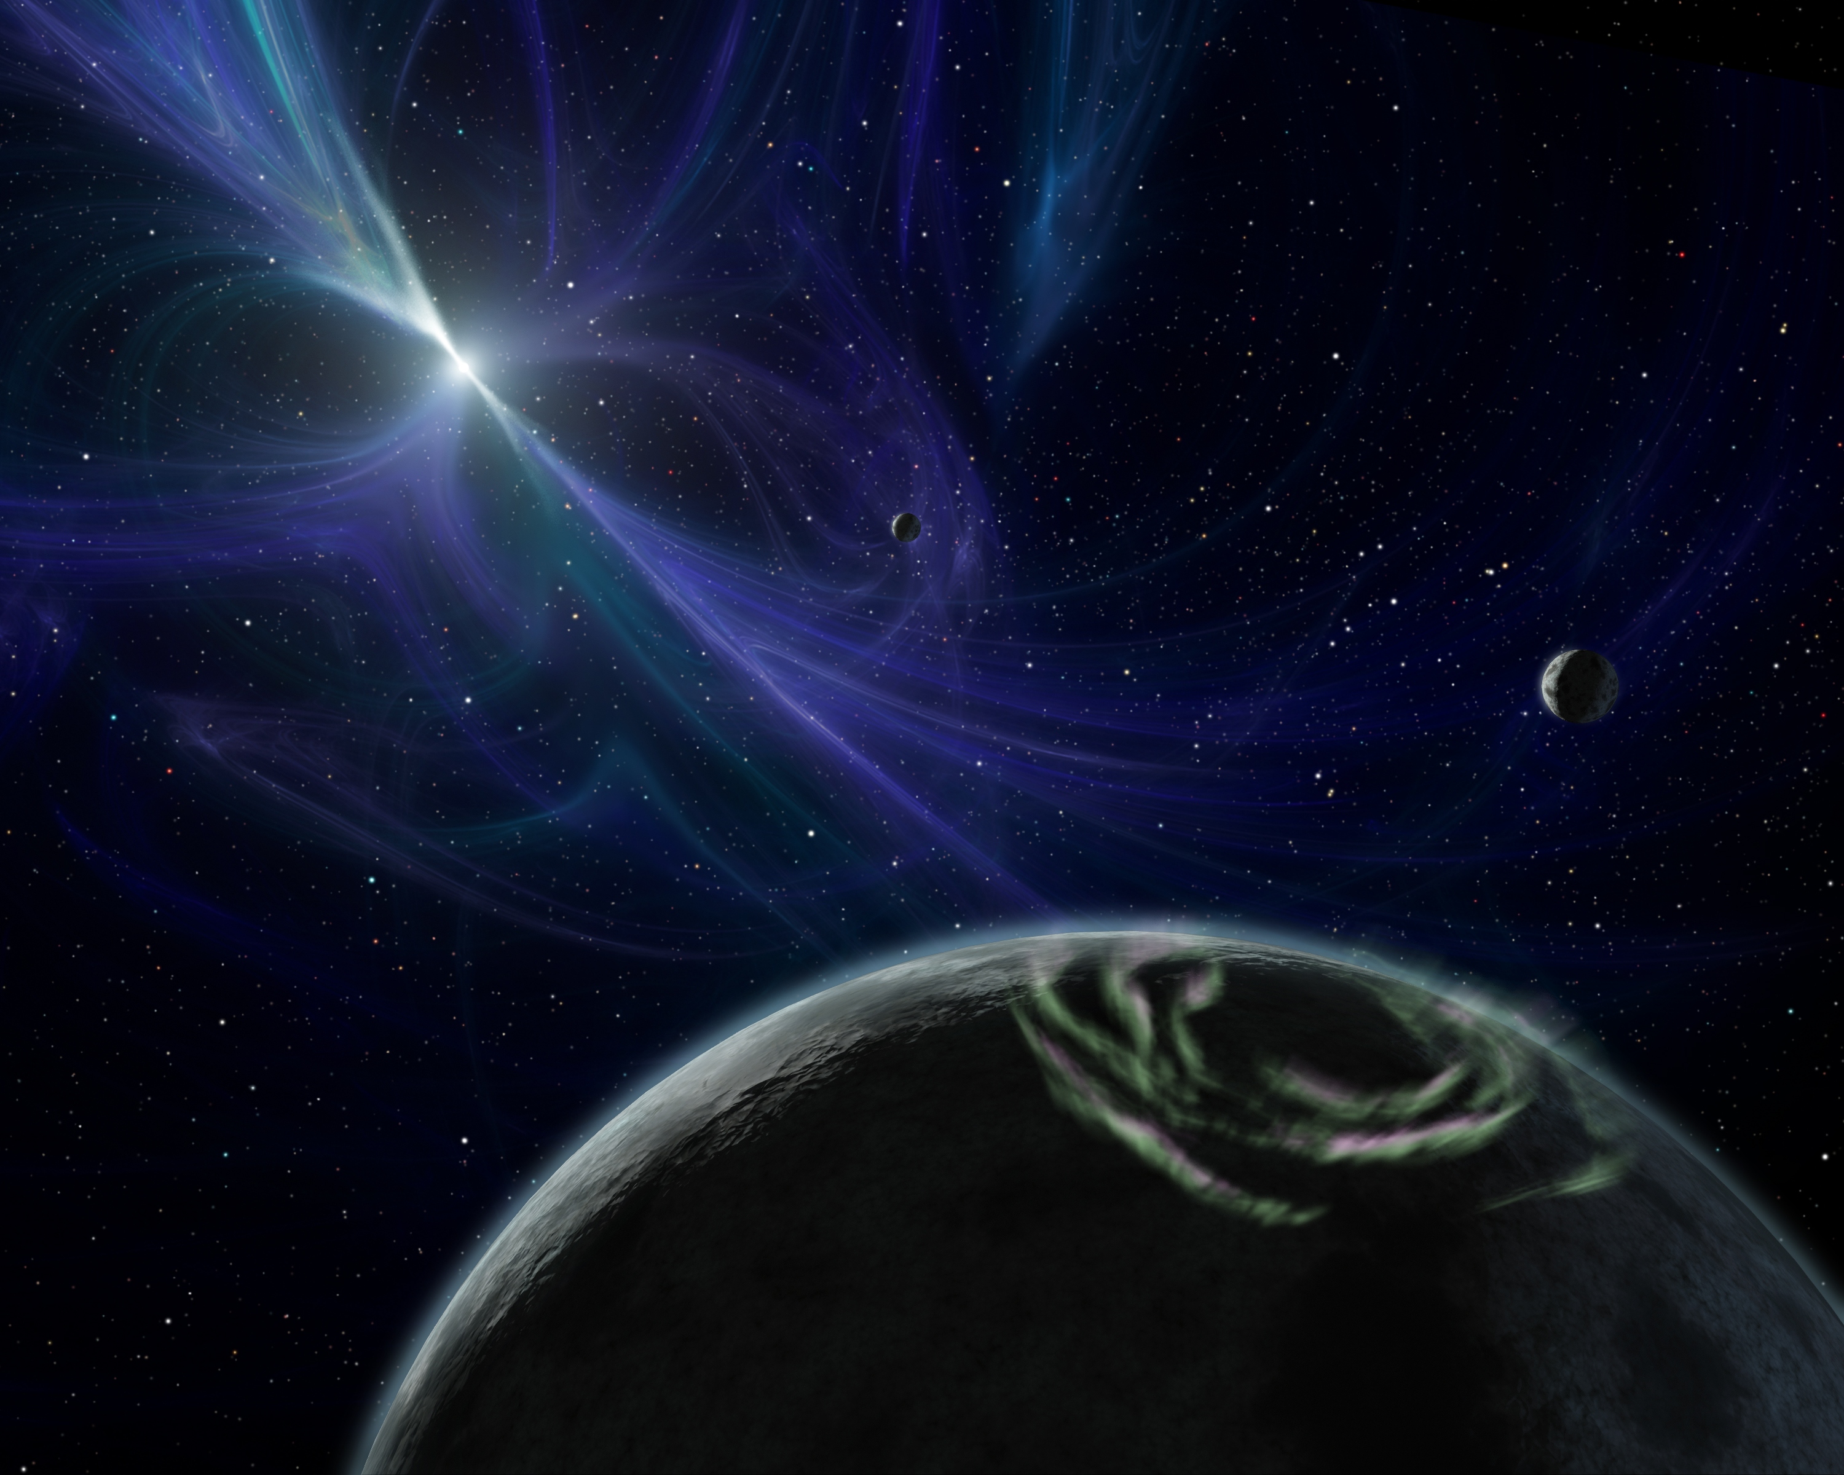
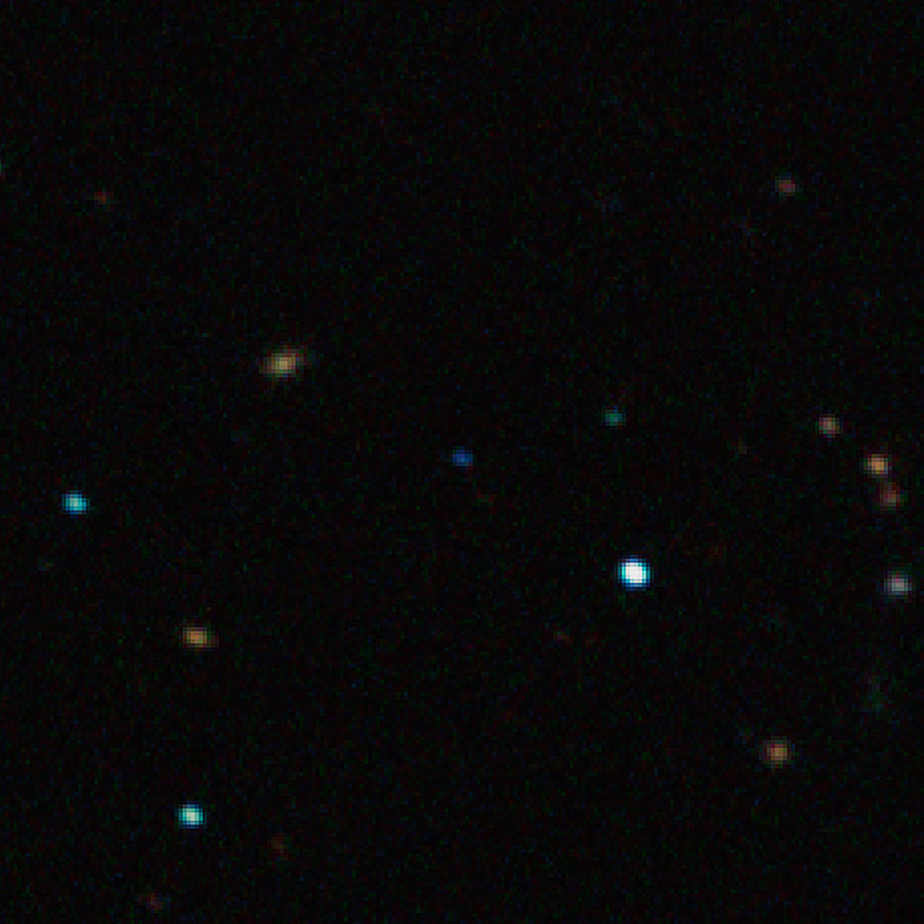
Which of these strange types of objects have astronomers discovered outside of our solar system?
Large gas giants with very small orbits called 'Hot Jupiters'
Planets in orbit around stellar remnants like neutron stars and pulsars
Massive terrestrial planets called 'Super Earths'
Free-floating planets that drift through interstellar space

